Slide 1
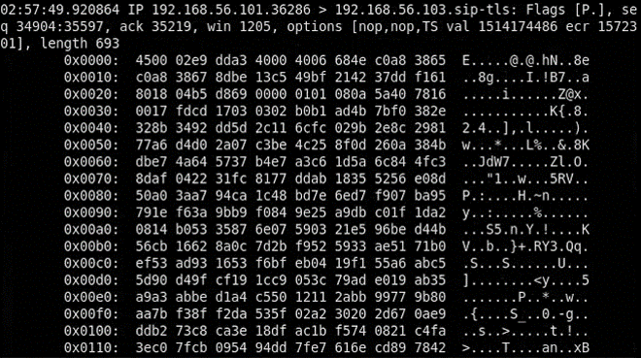
>Attacking encrypted VoIP protocols
HAXPO Amsterdam, May 2019 Ivica Stipovic

Slide 2
Biography
Name>Ivica [Eeveetsa] Stipovic
Work>Ward Solutions, Dublin, Ireland
Job>Information Security Consultant
Contact> Ivica.Stipovic@ward.ie
>EOF

Slide 3
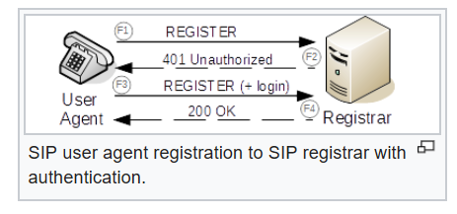
What is VoIP protocol ?
VOIP stands for (Voice Over IP) - Voice /Video/messaging that uses IP-based transport protocols for transmission
What is SIP?
SIP stands for Session Initiation Protocol (it is a voice control protocol), developed by IETF
SIP is one of the predominant VOIP control protocols
Source: https://en.wikipedia.org/wiki/Session_Initiation_Protocol

Slide 4
SIP,MGCP,H.323,XMPP…
There are other VoIP protocols as well
MGCP Media Gateway Control Protocol (MGCP), connection management for media gateways
H.323 - one of the first VoIP call signaling and control protocols that found widespread implementation
XMPP - Extensible Messaging and Presence Protocol , instant messaging, presence information, and contact list maintenance
Skype protocol, proprietary Internet telephony protocol suite based on peer-to-peer architecture
…etc

Slide 5
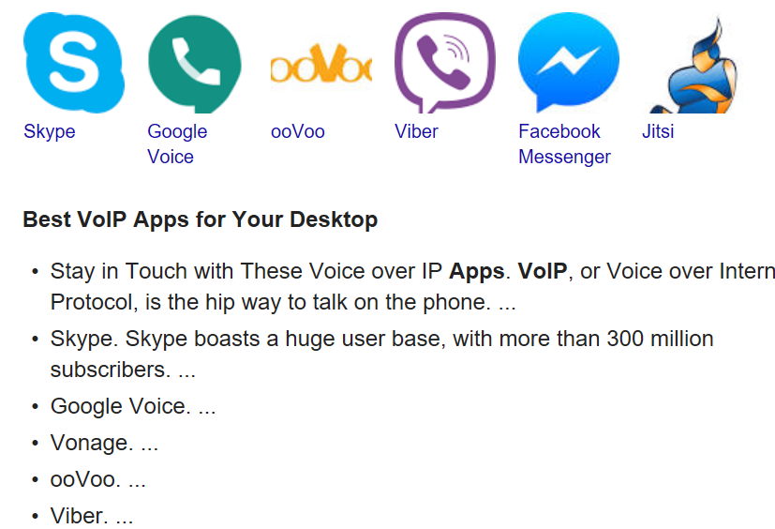
What applications are using VoIP?
This is a small snapshot of the most popular VoIP applications.
Not all of them use SIP, though:
Skype uses proprietary protocol
Viber does use SIP, so as Blink,
Cisco IP Communication, Jitsi,
Bria, Empathy,Linphone,X-Lite,
Zoiper,Yahoo! Messenger…

Slide 6
Let’s talk about SIP
SIP by default runs as a UDP service over the port 5060
By default, it is not encrypted
Full description of SIP protocol is given in the https://tools.ietf.org/html/rfc3261
SIP structure is very similar to HTTP session structure (both request and response paradigm)

Slide 7
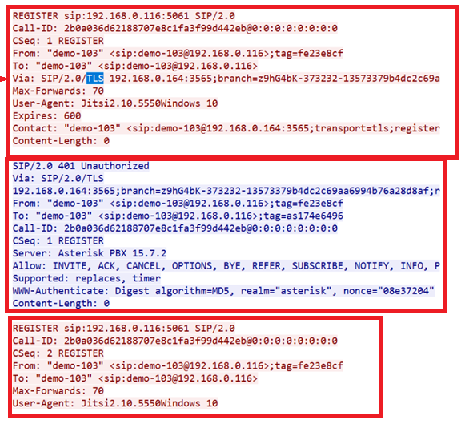

Structure of a SIP session
Similar to HTTP
Request (REGISTER vs GET)
Response (Unathorised
Return code 401)
Request (REGISTER vs GET)

Slide 8
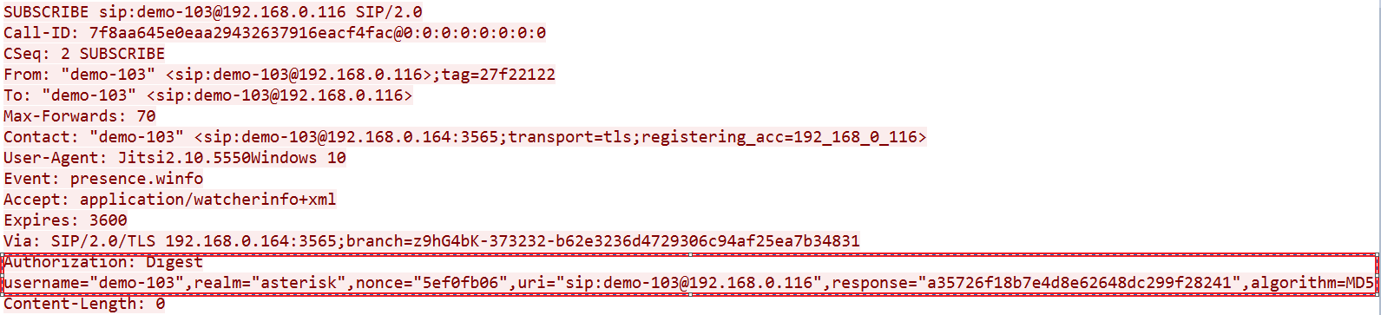
Attributes of a SIP session
We will focus on attributes required to facilitate password attacks. These are: algorithm, method, username, realm, uri,response,nonce,{nc},{cnonce} and {qop}

Slide 9
Why TLS/encryption?
wrapping SIP into TLS makes it more secure (HTTP vs HTTPS, POP3 vs POP3S, LDAP vs LDAPS etc.)
interception of encrypted SIP will show obfuscated application layer payload
only ip/tcp/udp header level information intelligible

Slide 10
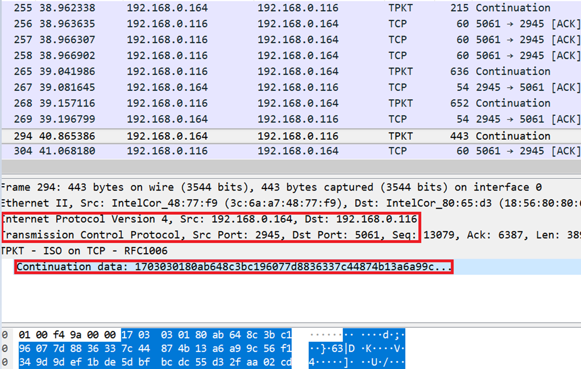
Why TLS/encryption?
-challenges to pentesters that TLS presents – we want the application layer
Lower OSI layers
Application layer
obfuscated

Slide 11
SIP –two aspects of attacks
1st aspect : interception + decryption
-for unencrypted SIP sessions, one focuses only on interception
-in our case, we need to do both
2nd aspect : SIP password cracking
-for unencrypted SIP sessions, off-the-shelf tools available in Kali
-in our case, we need to develop either:
-manual preparation of a file for sipcrack
-our own tool to streamline the cracking (<= chosen approach)

Slide 12
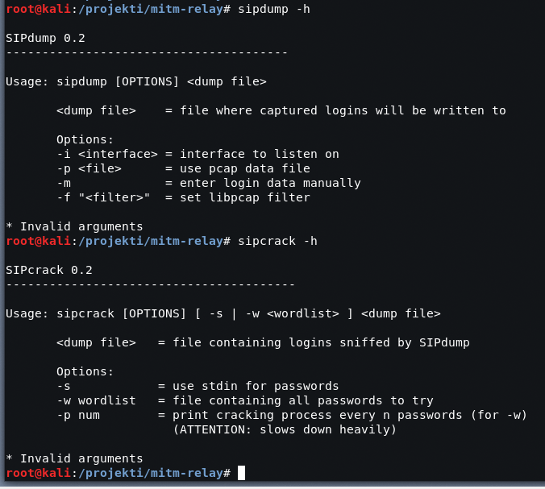
Attacking plaintext SIP passwords
-Kali with sipdump and sipcrack
-sipdump takes a pcap of a
SIP session as input and
generates a text file output
for sipcrack
-sipcrack takes the text output
from sipdump and performs
password dictionary attack

Slide 13
Solution design-1st part (interception and decryption)
An idea of MITM occurred as one plausible attack vector
This is what we need to achieve:
build a mechanism capable of intercepting and decrypting the TLS wrapped session
search for some kind of protocol-agnostic proxy capable of decrypting TLS
forward the traffic from this protocol-agnostic proxy to Burp so we can play with packets

Slide 14
Solution design-1st part (interception and decryption)
Burpsuite does that job No. 1, but only for HTTP(S) – it does not speak SIP or any other non-HTTP(S) protocols for that matter
The Solution: mitm_relay.py (https://github.com/jrmdev/mitm_relay)

Slide 15
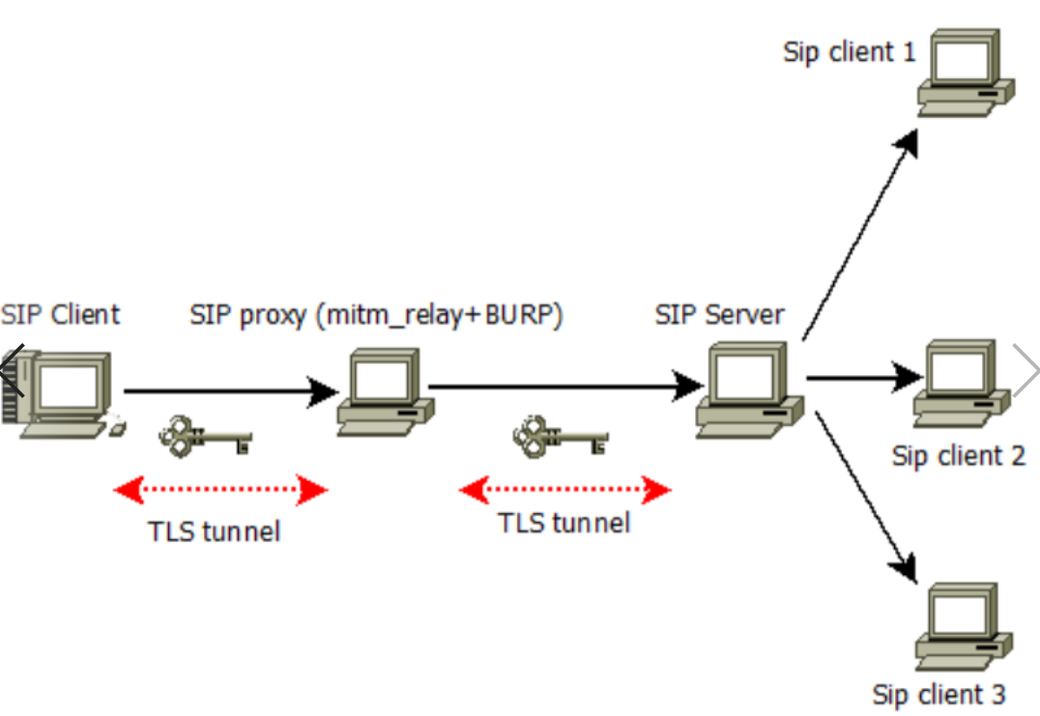
Solution design-1st part (interception and decryption)
-Topology design developed as below
-Key component: mitm_relay.py + Burpsuite running as SIP proxy on Kali
- you can have them on separate VMs too, also , no particular need for Kali – any linux will do, I guess

Slide 16
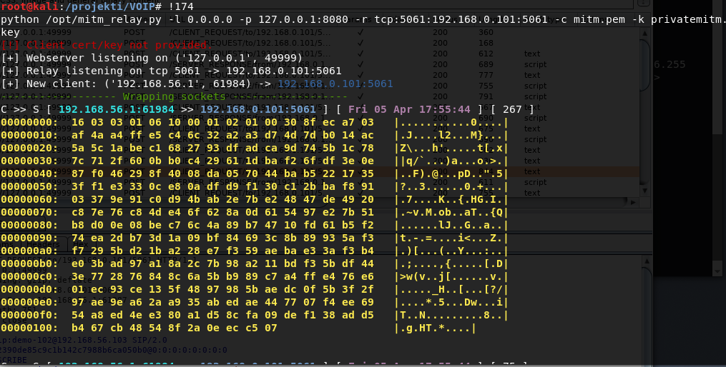
Chaining mitm_relay.py with Burp
-l 0.0.0.0 mitm_relay.py listens on all interfaces
-p 127.0.0.1:8080 Burp runs on localhost , port 8080
-r tcp:5061:192.168.0.101:5061 relay all traffic on tcp 5061 port to final SIP server running on 192.168.0.101, port 5061
-c mitm.pem digital certificate for mitm_relay.py
-k privatemitm.key private key for mitm_relay.py

Slide 17
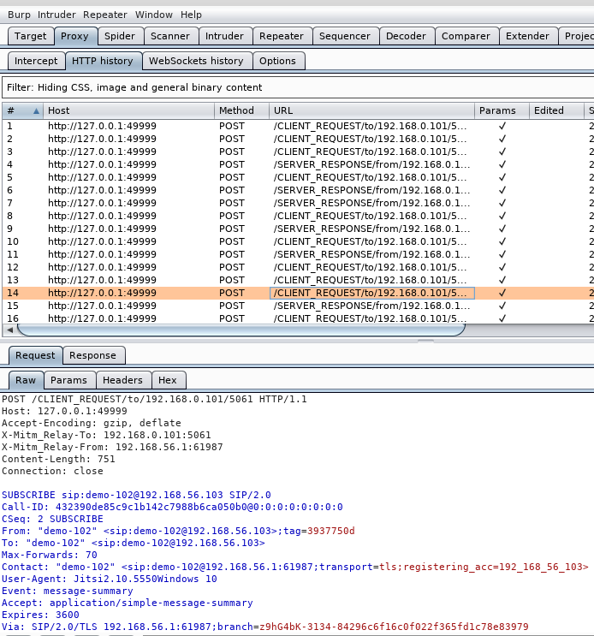
Chaining mitm_relay.py with Burp
If we switch over to Burp, we can
see decrypted SIP negotiation
POST requests have embedded
“/CLIENT_REQUEST/to/<IP>” and
“/SERVER_RESPONSE/from/<IP>”
that allows Burp to process SIP
Sessions (it only transports stuff,
does not really speak SIP)

Slide 18
Chaining mitm_relay.py with Burp
Mechanics of the interception
SIP client ->mitm_relay.py->Burpsuite->SIP server->SIP client 2
NOTE: remember that now that we have Burp reading the SIP, several other attacks can be mounted :
-send SIP request to Burp Repeater,
-change call destinations,
-brute force destination numbers,
-change user agent fingerprint ,
-inject some funky headers/establish covert channel attack,
-spoof calling ID…
Tampering in BURP is interesting, but out of scope of this research

Slide 19
Solution design - 2nd part (coding new app)
Why is new app required –what about sipdump and sipcrack?
-sipdump will not work here –we have dumped the decrypted session into a non-pcap format
-sipdump has no way of importing the private key to decrypt the captured wireshark pcap session
-we can decrypt wireshark pcap, remember? – we possess the private key for mitm_relay.py
What is new app doing?
-new app will process the mitm_relay.py dump which is more-less text based file and will extract all authentication attributes and perform password dictionary-based attack

Slide 20
Solution design - 2nd part (coding new app)
Functional mapping of sipdump+sipcrack into sipcrack2
Streamline mitm_relay dump parsing with password cracking
How do we crack digest algorithm?
-https://www.ietf.org/rfc/rfc2069.txt later ammended by RFC 2617
-{qop},{nc},{cnonce} increase the variability of hashing but will still not protect against our attack and all these attributes can be intercepted and decrypted

Slide 21
Solution design - 2nd part (coding new app)
Digest authentication algorithm
If {qop},{cnonce} and {nc} are not defined (RFC2069) then
H1=MD5(username:realm:password)
H2=MD5(method:uri)
Response=MD5 (H1:nonce:H2)
Else if {qop},{cnonce} and {nc } are defined (RFC2617) then
Response=MD5(H1:nonce:nc:cnonce:qop:H2)
https://github.com/adenosine-phosphatase/sipcrack2

Slide 22
Final thoughts
Development
sipcrack2 is for now just a linux version, hope to release Windows version with
CUDA/multithreading & parallel processing in a near future
How realistic/difficult is the attack?
The attack shown is relatively difficult to implement (ARP poisoning required to
redirect the traffic from legitimate proxy to the attacker)
Recommendations
-use strong passwords
-do not use self-signed certificates
-use client side certificate in addition to server
Risk rating proposed: Medium

Slide 23

Demo

Slide 24

Questions? Shutting down

